Slide 1

HEART DISEASE PREDICTION
A MINOR PROJECT POWER POINT PRESENTATION
Submitted to
LNCT UNIVERSITY BHOPAL (M.P)
MINOR PROJECT REPORT
Submitted by
Aniket Kumar [LNCBBCAAI030]
Aniket Patidar [LNCBBCAAI029] Anjali Rajput[LNCBBCAAI032] Anfal Umar[LNCBBCAAI028]
Under the supervision of
Prof. Aditya Tiwari
School of Engineering and Technology LNCT UNIVERSITY BHOPAL (M.P)
Session 2023

Slide 2
INTRODUCTION
Cardio-Vascular diseases are the primary cause of death worldwide over
the past decade. According to the World Health Organization it is
estimated that over 17.9 million death occur each year because of cardiovascular diseases and out of these deaths 80% is attributed to coronary artery disease and cerebral stroke
Various risk factors such as smoking, overuse of alcohol and caffeine, stress, and physical inactivity along with other physiological factors like obesity, hypertension, high blood cholesterol, and pre-existing heart conditions are often deciding factors for heart disease
The major challenge faced in the world of medical sciences today is the
provision of quality service and efficient and accurate prediction. The later problem can be solved by automation with the help of Data Mining and Machine Learning. Data mining is defined as a process used to extract
usable data from a large set of raw data. It implies analyzing patterns in large batches of data by making use of various software. It also involves
effective data collection and warehousing coupled with computer Processing.

Slide 3
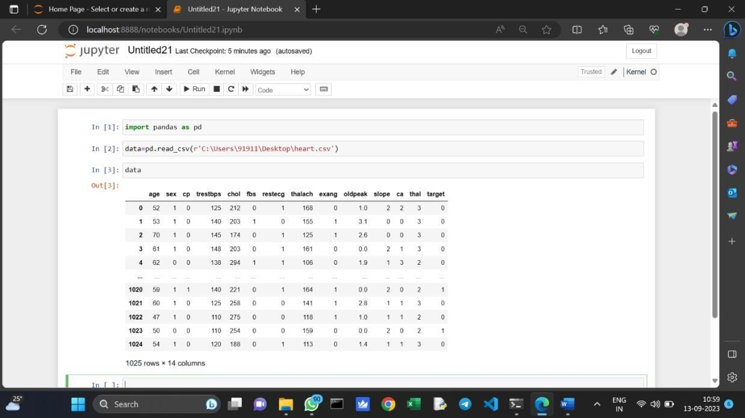
KEY STEP :
OBJECTIVE : main objective behind the project is to predicate heard disease before heart attack
Data Collection:
Gather a comprehensive dataset containing the relevant information for various Heart disease, including both numerical and categorical features.

Slide 4
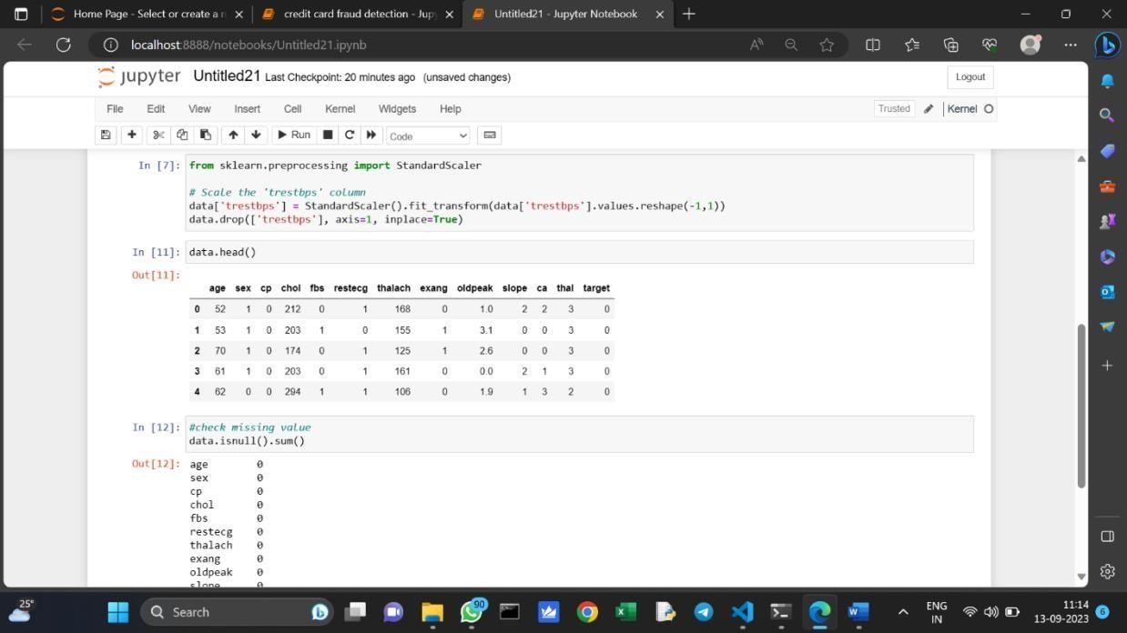
Data pre-processing
Pre-processing is the process of three important and common steps as follows:
Formatting
Cleaning
Sampling

Slide 5
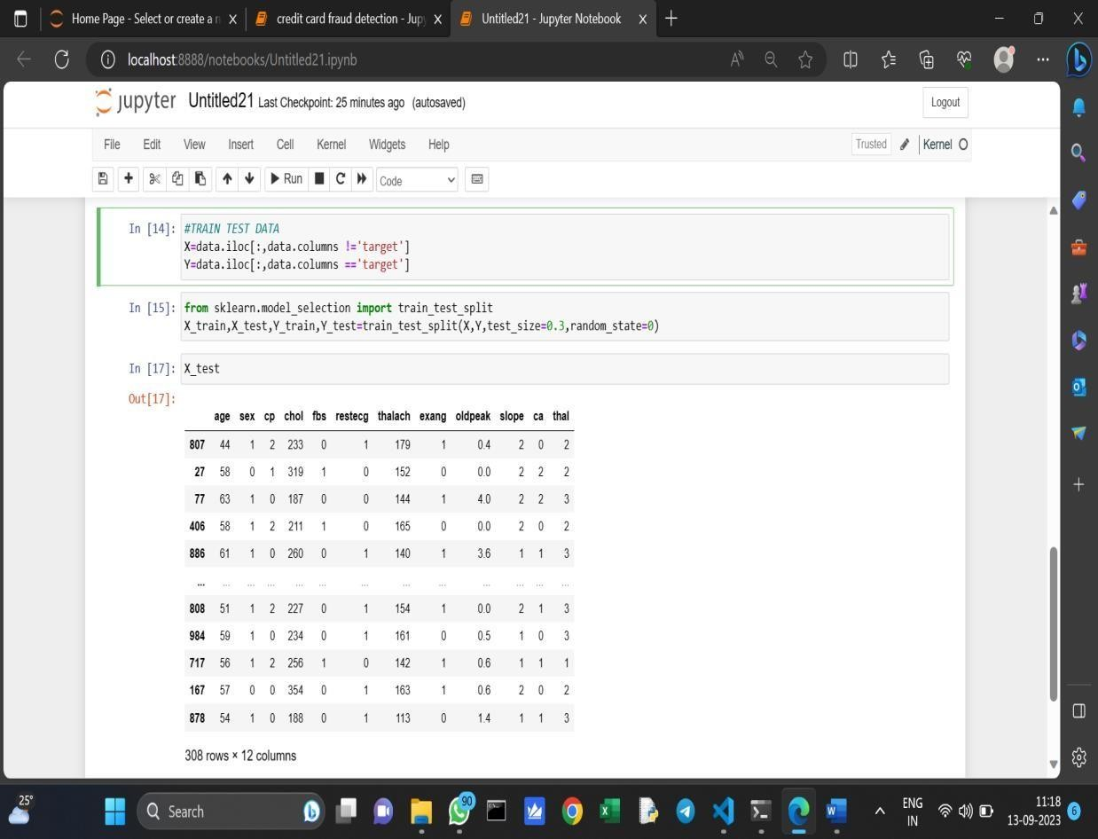
Feature extraction
Feature extraction is the process of studying the behaviour and pattern of the analysed data and draw the features for further testing and training.

Slide 6
Evaluation model
Model Evaluation is an essential part of the model development process. It helps to find the best model that represents our
data and how well the selected model will work in the future. Evaluating model performance with the data used for training is not acceptable in data science because it can effortlessly generate overoptimistically and over fitted models.

Slide 7
WHAT IS MACHINE LEARNING MODEL ?
A machine learning model is a program that can find patterns or make decisions from a previously unseen dataset. For example, in natural language processing,
machine learning models can parse and correctly
recognize the intent behind previously unheard sentences or combinations ofcorrect .
WHAT IS CLASSIFICATION ?
Classification is a supervised machine learning method where the model tries to predict the correct label of a given input data. In classification, the model is fully
trained using the training data, and then it is evaluated on test data before being used to perform prediction on new
unseen data.
WHAT IS SUPPORT VECTOR ?
It is a supervised machine learning problem where we try
to find a hyperplane that best separates the two classes.
Note: Don’t get confused between SVM and logistic regression. Both the algorithms try to find the best

Slide 8
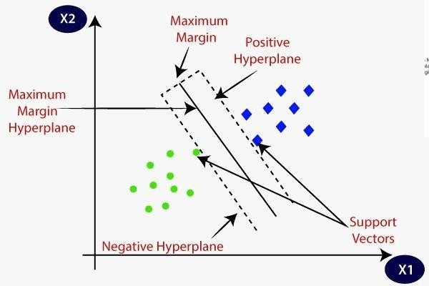
hyperplane, but the main difference is logistic regression is a probabilistic approach whereas support vector machine is based on statistical approaches.
Now the question is which hyperplane does it select?
There can be an infinite number of hyperplanes passing through a point and classifying the two classes perfectly. So, which one is the best.

Slide 9
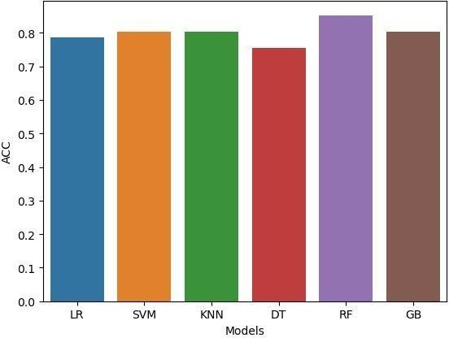
Accuracy Chart of different model

Slide 10
CONCLUSION
The primary objective of this study was to classify heart disease using different models and a real-world dataset. The k-modes clustering algorithm was applied to a dataset of patients with heart disease to predict the presence of the disease. The dataset was pre-processed by converting the age attribute to years and dividing it into bins of 5-year intervals, as well as dividing the diastolic and systolic blood pressure data into bins of 10 intervals. The dataset was also split on the basis of gender to take into account the unique characteristics and progression of heart disease in men and women.
The elbow curve method was utilized to determine the
optimal number of clusters for both the male and female
datasets. The results indicated that the MLP model had the highest accuracy of 87.23%. These findings demonstrate the potential of k-modes clustering to accurately predict heart disease and suggest that the algorithm could be a valuable tool in the development of targeted diagnostic and treatment strategies for the disease. The study utilized the Kaggle cardiovascular disease dataset
with 70,000 instances, and all algorithms were implemented on Jupiter notebook pad.

Slide 11
THANK YOU

